Slide 1
Carbon Tax and Its Impact to Albertans
January 21, 2017

Slide 2
What is Carbon ? Greenhouse Gases?
Carbon is an element that's found all over the world and in every living thing (Atmosphere, Ocean, soil, underground, living things).
Carbon dioxide (CO₂) is emitted from natural and anthropogenic (human-induced) sources.
A gas that contributes to the greenhouse effect by absorbing infrared solar radiation, e.g., (CO₂, N₂O, CH₄, PFC, HFC, SF₆).
Greenhouse gases that trap solar radiation, which will heat the earth.
When the conc.of CO₂ exceeds the level than it is taken by the earth systems, it creates greenhouse effect on Earth System.

Slide 3
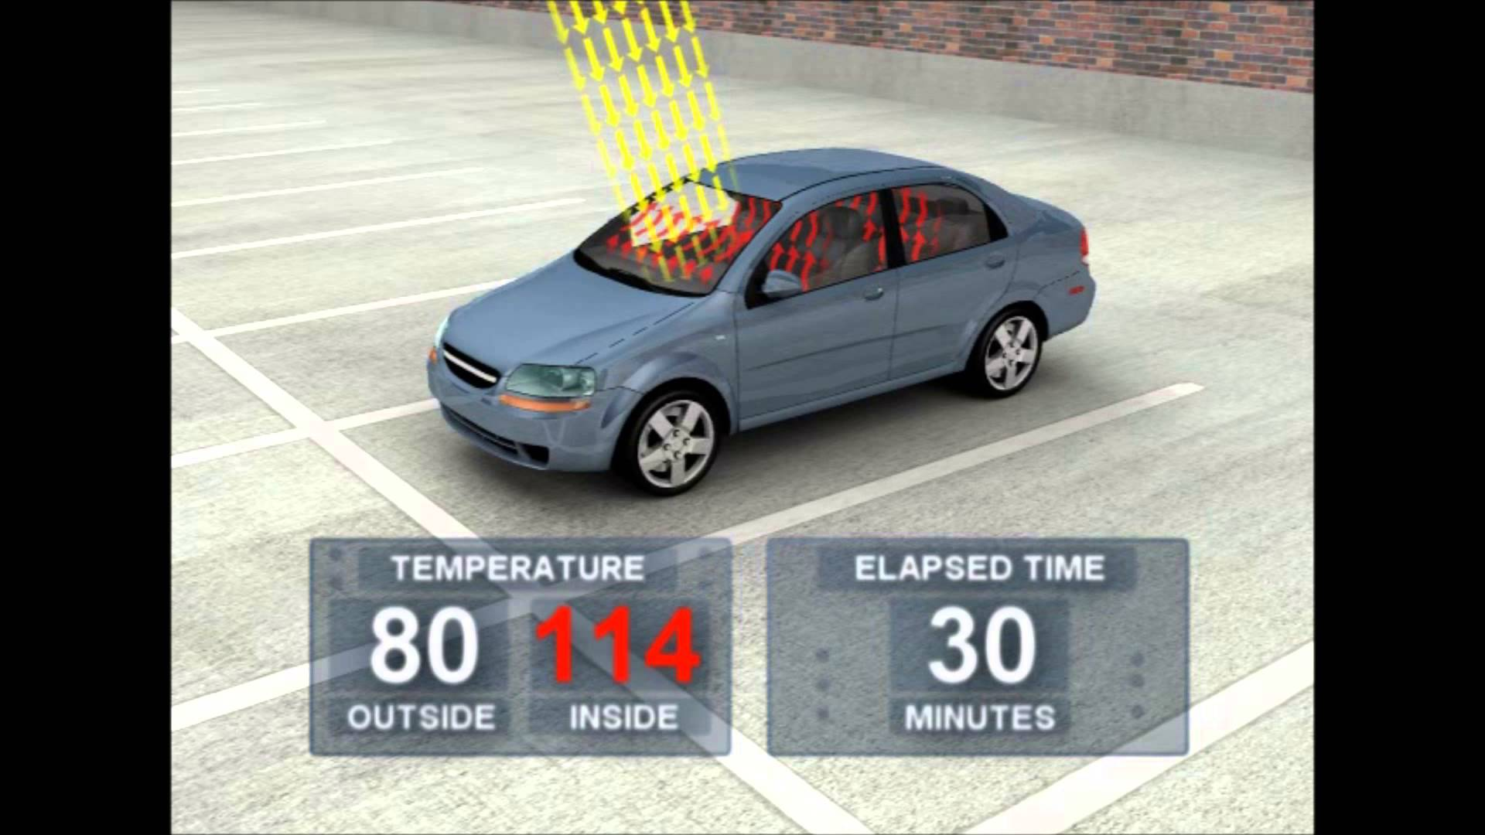
What is Greenhouse ?
26 C to 45.56 C

Slide 4
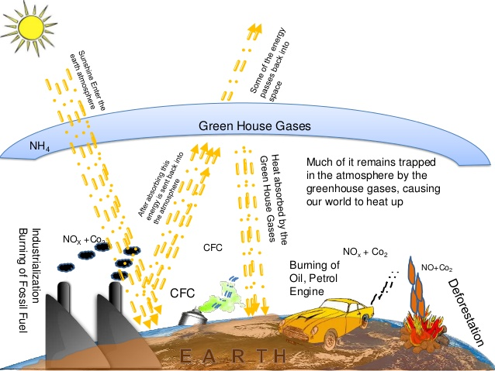

Greenhouse Gas Theory and Practice

Slide 5
Greenhouse Gases and Their Global Warming Potentials
 | Global warming Potential (GWP) relative to CO2
Greenhouse gas | Chemical formula | GWP for 100-year time horizon
Carbon Dioxide | CO₂ | 1
Methane | CH₄ | 25
Nitrous oxide | N₂O | 298
Sulphur hexaflouride | SF₆ | 22800
Perfluorocarbons | PFC -14 (CF₄) Perfluorocyclopropane (c-C₃F₆) | 7390->17340
Hydrofluorocarbons (HFC) | HFCF-23 (CHF₃)-HCFC-142b (CH₃CCL₂F) | 151-2310

Slide 6
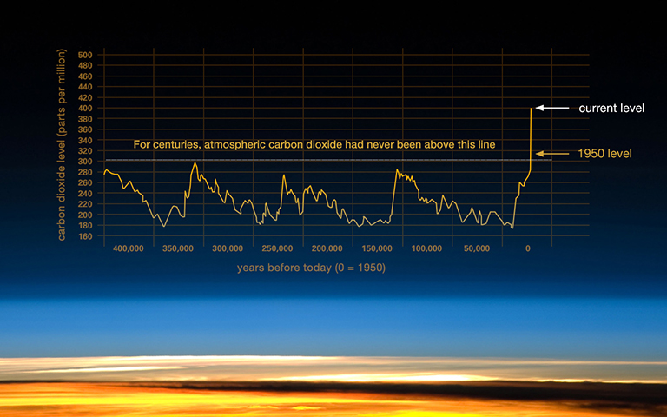
The Relentless Rise of Carbon Dioxide
http://climate.nasa.gov/climate_resources/24/

Slide 7
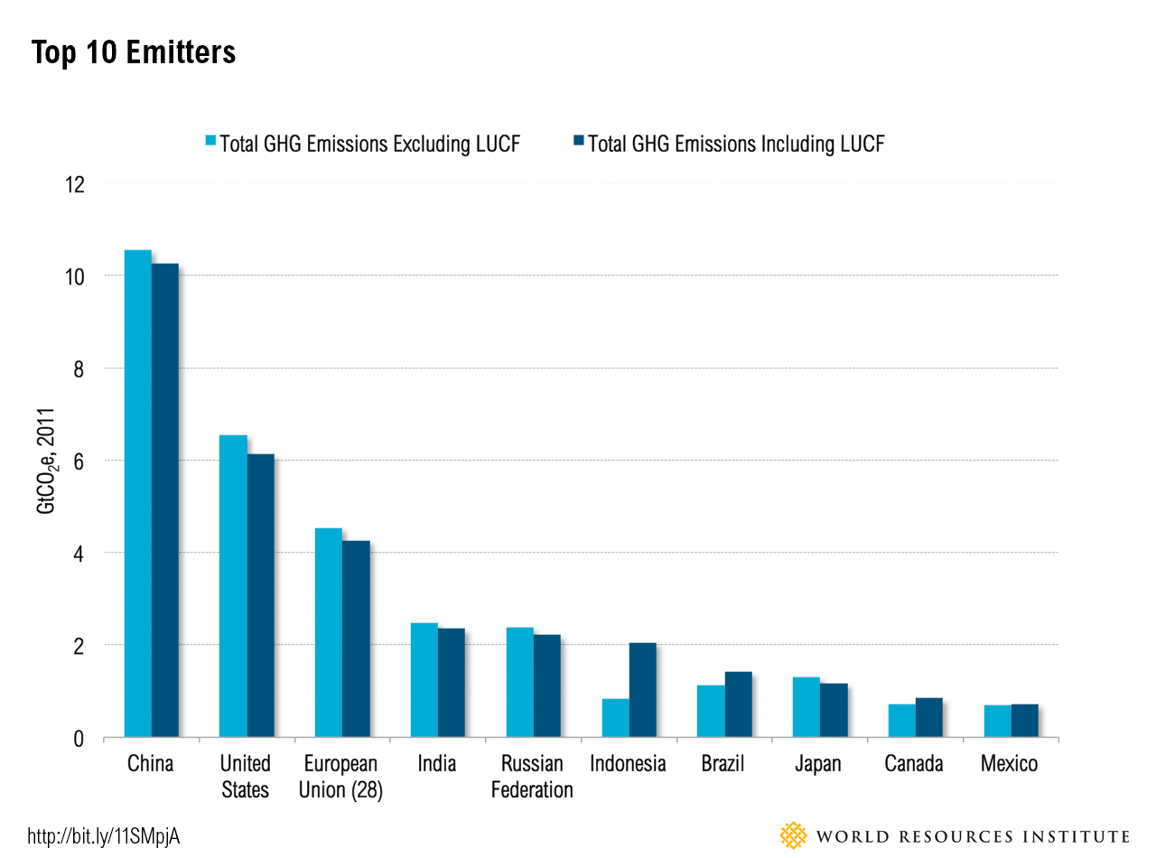
Top 10 Global CO₂ Emitters

Slide 8
Global share of emissions by % (2014)
Total =67 % of global emissions (33 % by rest of the world)

Slide 9
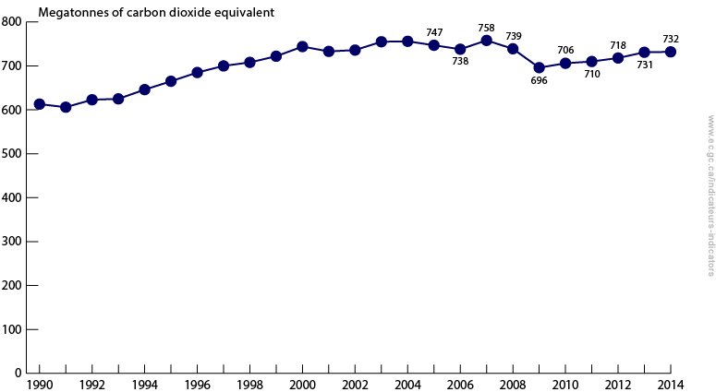
Canada National GHG emissions
Source: Environment and Climate Change Office

Slide 10
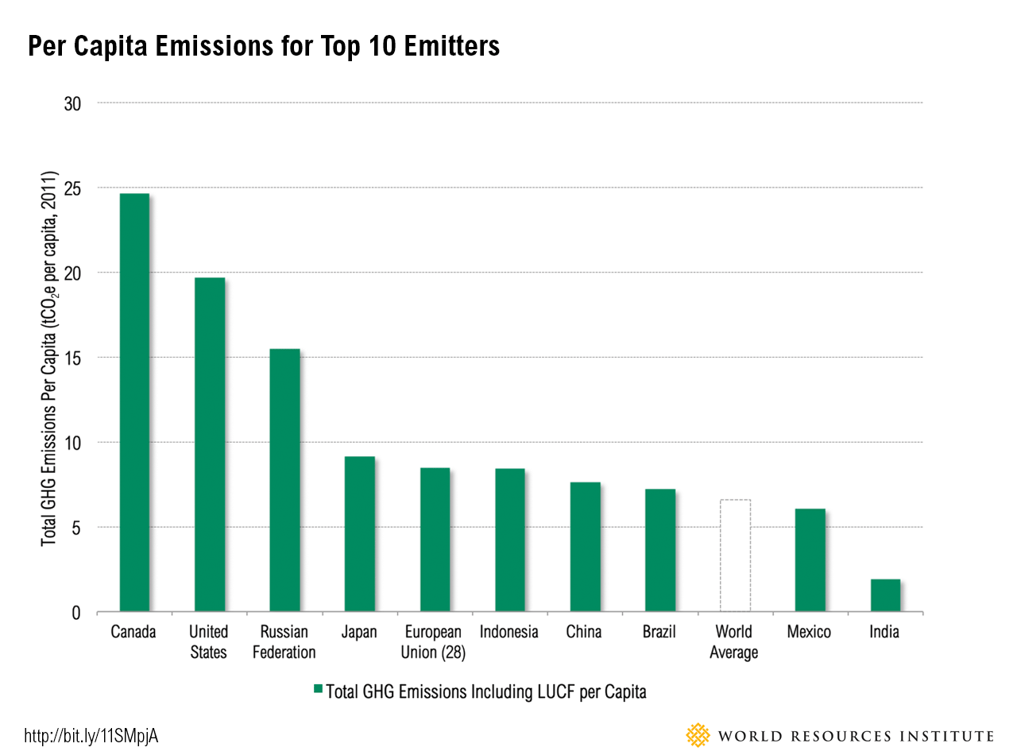
Per Capita CO₂ emissions for top 10 Countries in the world (tonnes per capita)
30,000,000 x24 =720,000,000 MT

Slide 11
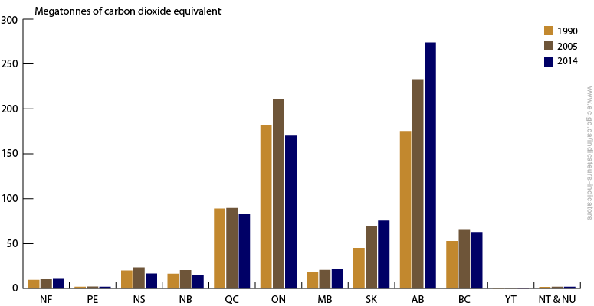
Provincial GHG emissions-Historical

Slide 12
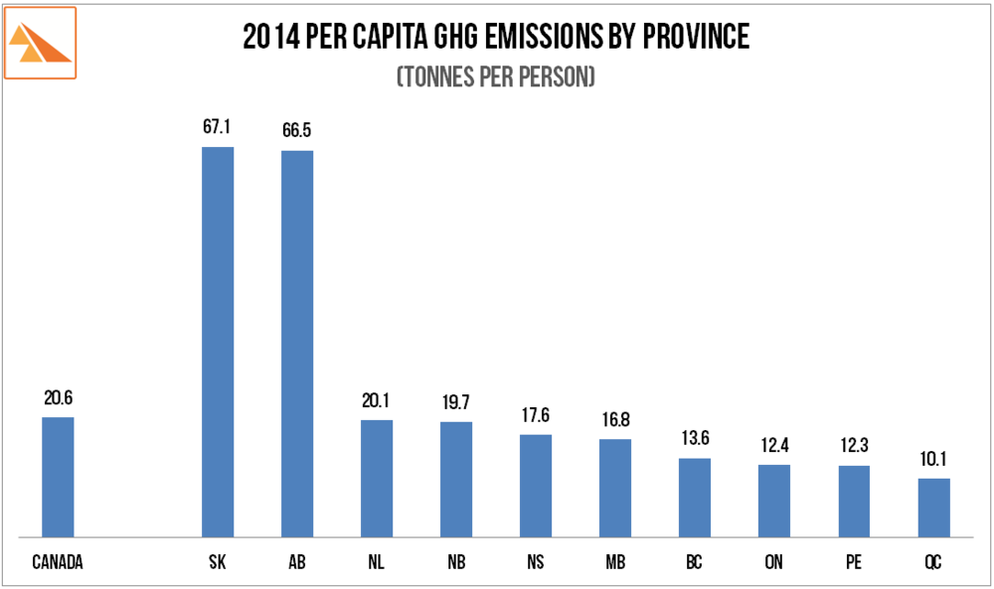
Per capita emissions from provinces

Slide 13
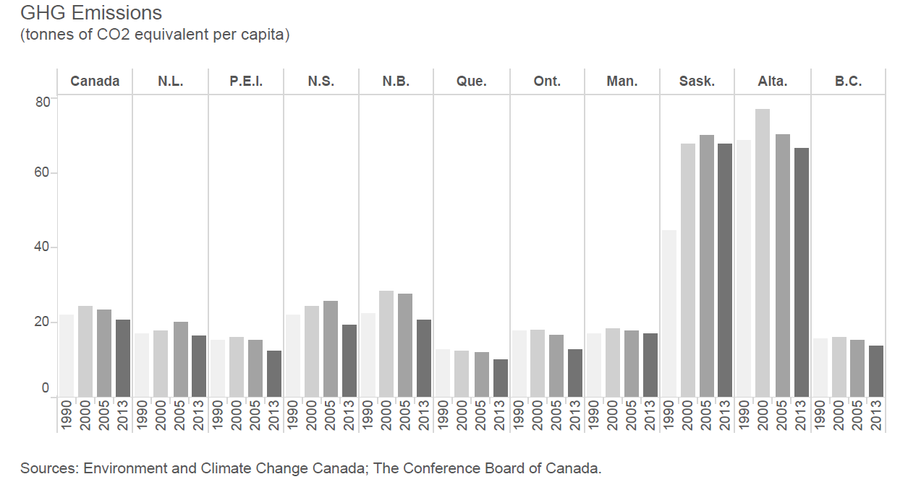
Provinces GHG Emissions-Historical
(tonnes per capita)

Slide 14
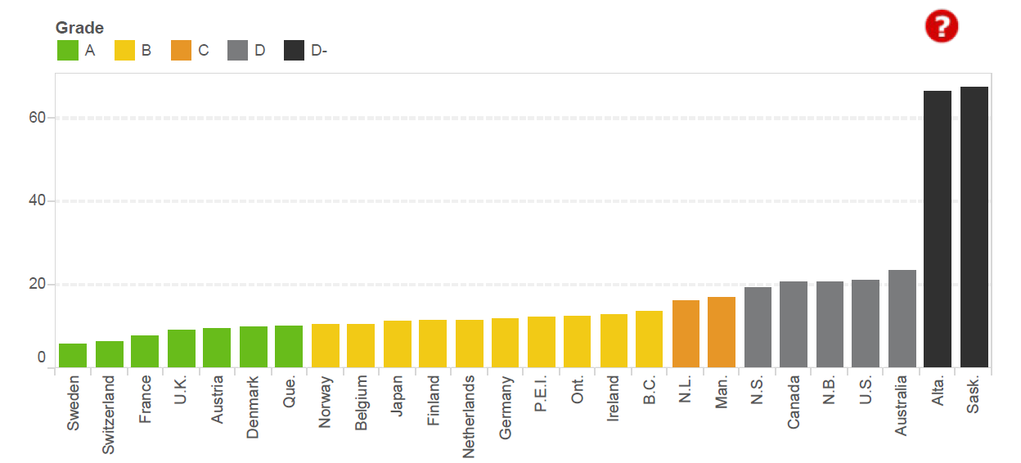
GHG Emissions, Provinces and International Peers, 2013
(tonnes of CO₂ equivalent per capita)
TE 2014 =267 MT
TE 2014 =53.9 MT
Sources: The Conference Board of Canada; Environment and Climate Change Canada; OECD

Slide 15
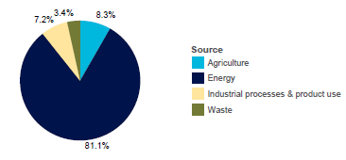
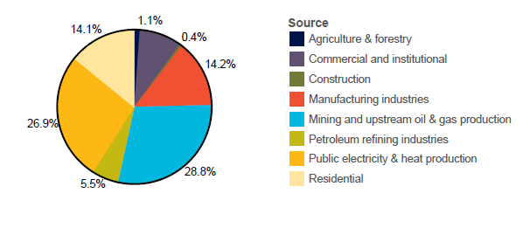
GHG Emissions by Source in Canada (2013)
(000’ tonnes of CO₂ emitted)

Slide 16
GHG emissions for 30 Phase 1 Oil Climate Index (OCI) test oils globally.
Alberta Climate Leadership Report 2016

Slide 17
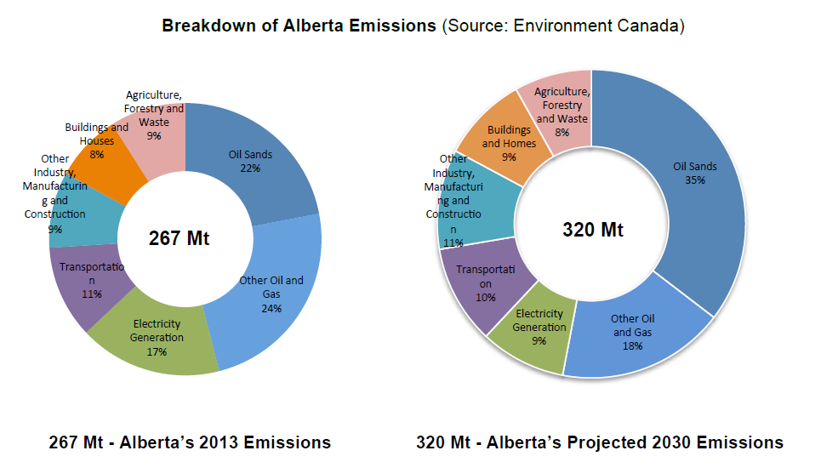
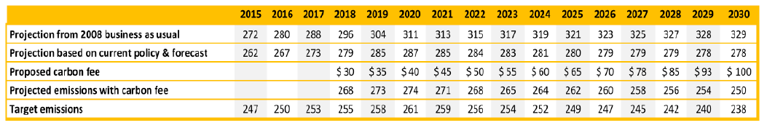
Emissions forecast under different carbon price
58 Mt
112 Mt
capped at 100 Mt
Alberta Climate Leadership Plan Report

Slide 18
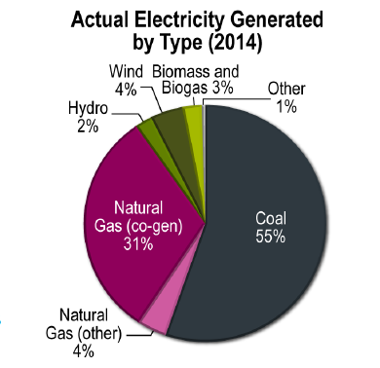
Electricity Generation by Fuel Source
Alberta
Canada

Slide 19
GHG Emissions Intensity of Electricity Generation Mix of Canadian Provinces, 2014

Slide 20
Alberta Carbon Tax –Effective from Jan 1, 2017
Alberta Carbon Tax in effect on January 1, 2017
Type of fuel used | Direct Impact
 | carbon tax rate for 2017 | carbon tax rate for 2018
Gasoline (petrol) | 4.49 c/litre | 6.73 c/litre
Natural Gas | $1.011 /GJ | $1.517 /GJ
Aviation jet fuel | 5.17 c/litre | 7.75 c/litre
Diesel | 5.35 c/litre | 8.03 c/litre
Propane | 3.08 c/litre | 4.62 c/litre
Electricity | No carbon Tax
Economy-wide Carbon Tax $20/t (2017); $30/t (2018) $ 9.6 billion will be collected over 5 years
 | Max. Net Income | 2017 Carbon Tax | Potential rebate
Single person | $47,000 | $191 /year | $200/year
Couple or Family | $95,000 | $338/year | $360 /year
Partial Rebate –single Partial Rebate –couple Couple with 4 children | $47,000-51,250 $100,000-$103,750 $103,000 -$108,250 | varies | varies

Slide 21
Rebates – based on income
Rebate income parameters |  | 2017 | 2018
Rebate amounts | First adult | $200 | $300
 | Spouse/Equivalent to spouse | $100 | $150
 | Each child (maximum 4) | $30 | $45
Maximum income to receive full rebate | Single | $47,500 | $47,500
(Family Net Income) | Couple | $95,000 | $95,000
 | Families | $95,000 | $95,000
Maximum income to receive partial rebate | Single | $51,250 | $55,000
(Family Net Income) | Couple | $100,000 | $103,750
 | Couple with 1 child | $100,750 | $104,875
 | Couple with 2 children | $101,500 | $106,000
 | Couple with 3 children | $102,250 | $107,125
 | Couple with 4 children | $103,000 | $108,250
Rebates: $400 or more delivered in 4 payments (Jan, Apr, Jul, Oct), $200-$399 delivered in 2 payments (Jan, Jul), $100-$199 delivered in 1 payment (Jan 2017 for the 2016-17 benefit year; July in subsequent years, beginning with July 2017), no payment for less than $100 rebate.
http://www.cbc.ca/news/canada/calgary/multimedia/alberta-carbon-tax-calculator-1.3900339

Slide 22
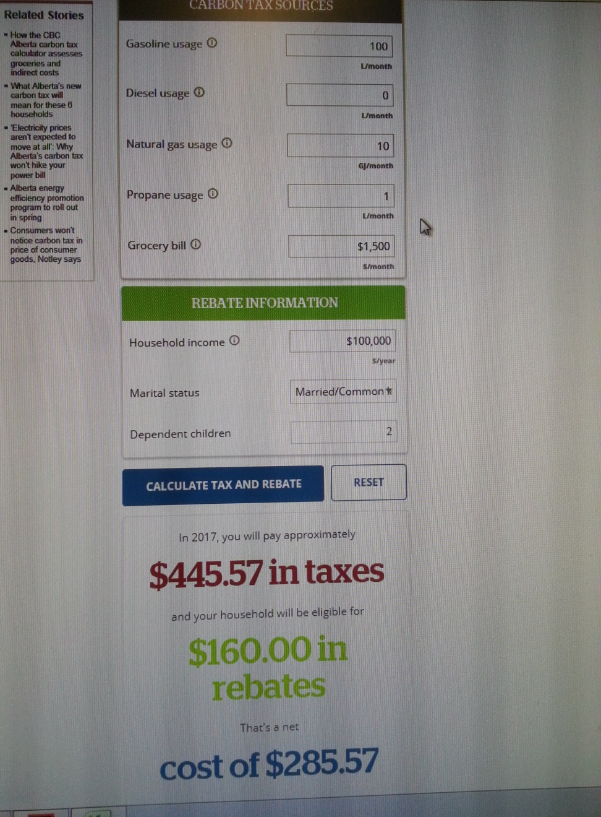
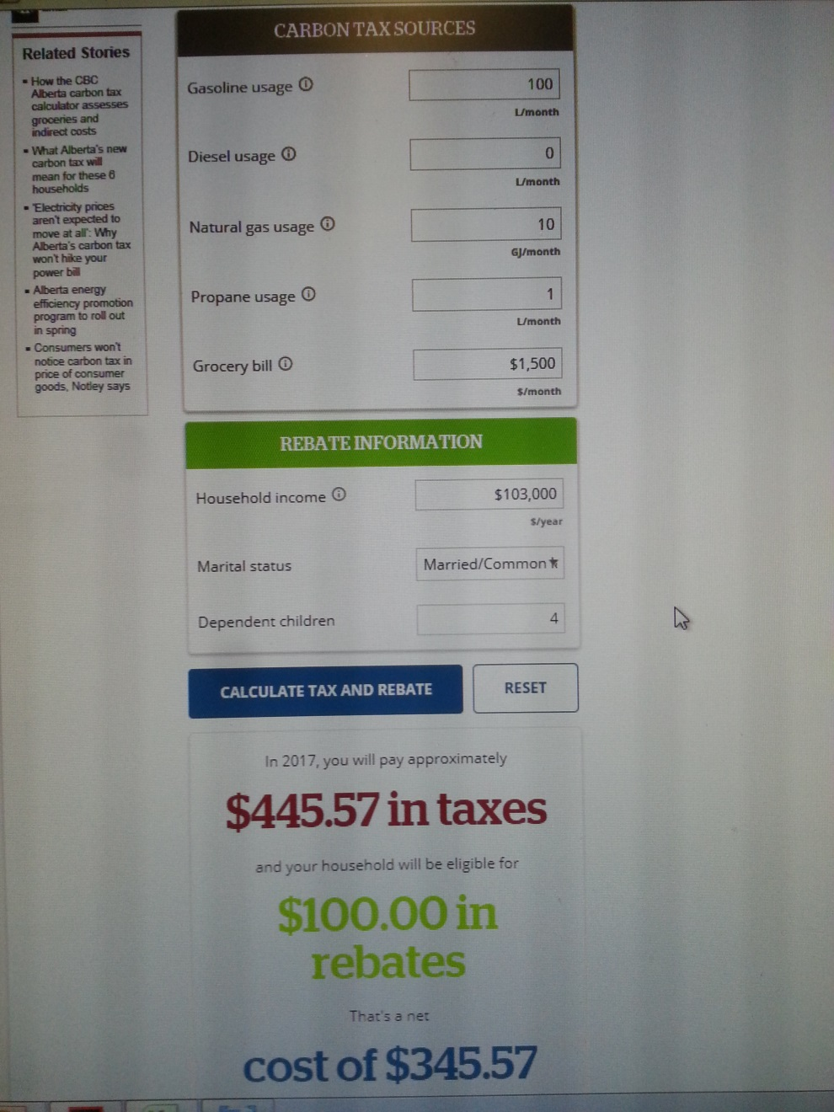
How much will it cost to us?

Slide 23
How much we emit? How much we contribute?
Consumption | CO₂ (g/l) | CH₄ (g/l) | N₂O (g/l)
Diesel | 2663 | 0.133 | 0.4
Gasoline | 2289 | NA | 0.02
Natural Gas | 1918 (g/m³) | 0.037 (g/m³) | 0.035 (g/m³)
Average Alt. household =135 GJ/ year and 600 kWh /month ; 1 gigajoule (GJ) ~ 26 cubic meters (m3)/000’ltres
A gasoline car that consumes 100 liters a month, will use 1200 liters per year and produce (2289*1200/1000000)= 2.75 tonnes of CO2 and 0.02*1200/1000000=0.0000240 tonnes of N2O. As N₂O has 295 global warming potential, the CO2 equivalent =0.0000240*295+2.75 = 2.76 tCO₂ eq./year (~3 t). An average car in North America will produce about 4-5 tonnes of CO₂ annually.

Slide 24
Estimated direct costs of the carbon levy on a household per year
 |  | Single | Couple | Couple with 2 children
Typical fuel use | Natural gas use (GJ) | 100 | 123 | 135
 | Gasoline use (L) | 2,000 | 3,000 | 4,500
2017 cost and rebates | Natural gas cost | $101 | $124 | $136
 | Gasoline cost | $90 | $135 | $202
 | Total levy cost | $191 | $259 | $338
 | Full rebate | $200 | $300 | $360
2018 costs and rebates | Natural gas cost | $152 | $186 | $205
 | Gasoline cost | $134 | $202 | $303
 | Total levy cost | $286 | $388 | $508
 | Full rebate | $300 | $450 | $540
Note: The indirect costs of the carbon levy are estimated to range between $50 to $70 per household in 2017 and $70 to $105 per household in 2018.

Slide 25
Where does the money go?

Slide 26
Thank you.
Any questions ?

