Slide 1
Google Classroom Workshop
Presented by
Sudeep Manandhar
Information Technology & Communication Director
sudeep.manandhar@necase.ca
Nepalese Canadian Society of Edmonton (NECASE)
16 February 2020

Slide 2
Pre-requisites
DON’T FORGET THE URL (https://classroom.google.com)
Internet connection
Knowledge of
Gmail
Google drive
YouTube
Attachment
Scanning and uploading to Google Drive
Google Docs, Sheets, Slides, Drawings, Forms
Knowledge of Quiz, Assignment, Material
Burger menu, 3 dots menu
Laptop/Chromebook or Google Classroom app on Android/IOS
Teachers’ email naming convention
firstname.lastname@necase.ca
Students’ email naming convention
firstname.lastname@juneli.necase.ca

Slide 3
Admin. Work/Tasks
Only Google Administrator or Classroom Admin(if privilege is provided in advance) CAN CREATE ACCOUNTS for Teachers’ and Students’
For our workshop, it has been already created with all the teachers and student accounts necessary to go live with Google Classroom
Teachers can create the class, invite and mange the classroom activities and also leave the class (once quit teacher can’t come back until and unless admin. sends out the invitation

Slide 4
Workshop tasklist
Introduction to Google Classroom
Class creation
Sending student invitation
Creating topic
Sharing content to the student/whole class
Assigning and creating
Assignment
Quiz assignment
Questions
Material
Reuse Material
Grading the assignment

Slide 5
Introduction to Google Classroom
Online teaching management
Using e-material(Google Drive, Link, YouTube, Attachment)
Teach and learn wherever you’re by Steaming, creating classwork, quiz, material etc.
Student and material management
Easy grading and information management of class and topics discussed
Centralized document management and class calendar notification

Slide 6
Account creations and Class creation
Teachers’ and Students’ account are created by Google administrator/Classroom Admin. (if privilege provided)
Only classroom admin. Or teachers assigned to it can create the class

Slide 7
Sending student invite
Teachers’ or classroom admin. will send invite
Student login to their Gmail
Student must accept the invite
Link on Gmail re-directed to classroom.google.com
Default role is student until and unless classroom admin assigned teacher’s role
Student can see only their class activities and information

Slide 8
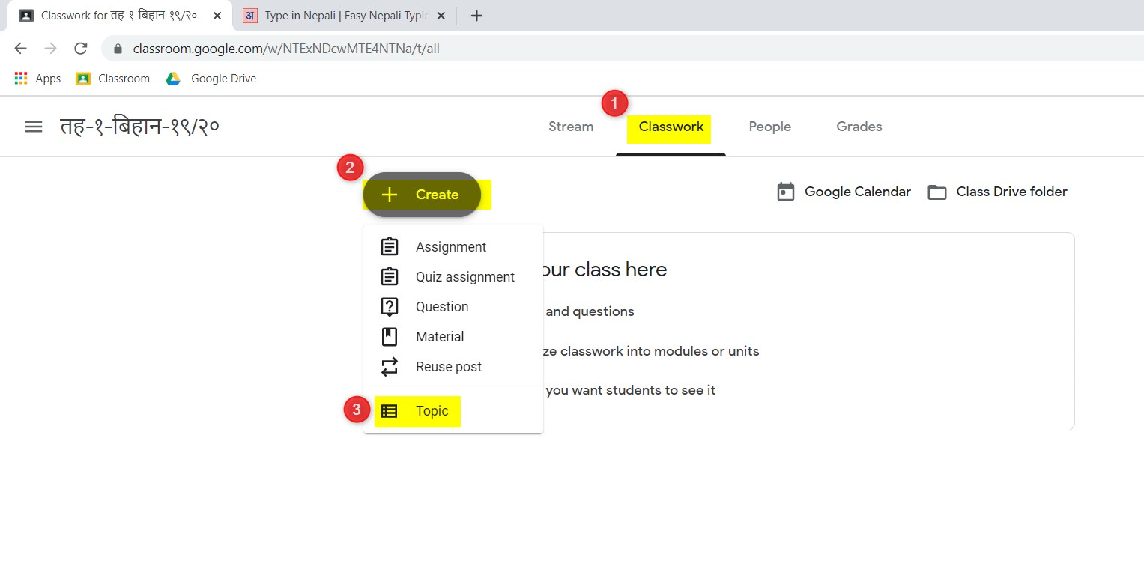
Creation of topic

Slide 9
Sharing content to the student/whole class
Streaming the content
Type in the box, “Share with your class”
Select “All students” or any single student
Select the material (Google Drive, Link, YouTube or Attachment uploaded to Google Drive in advance which might have scanned or any electronic material)

Slide 10
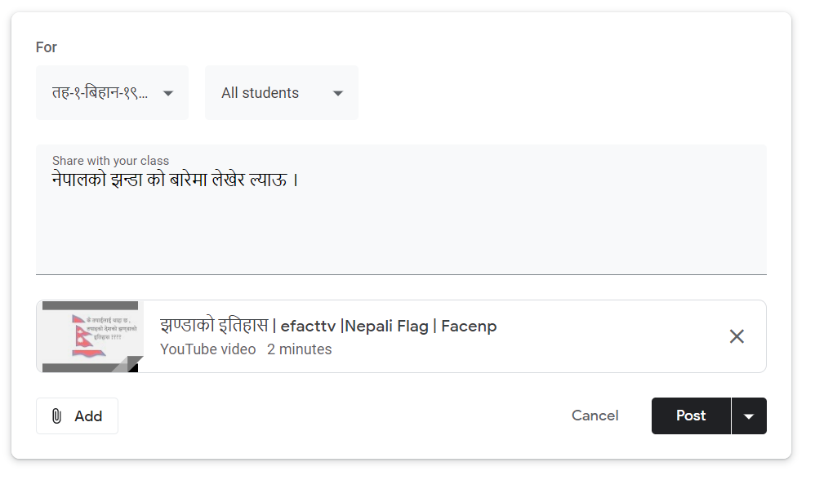
Sharing content to the student/whole class
Screenshot

Slide 11
Assigning and creating
Assignment
Homework like essay, comprehensive Q/A
Quiz assignment
Google Forms Quizzes question
Questions
Short Open Ended questions
Material
On to of Google Drive, Link, YouTube attachment
Google Docs, Sheets, Slides can be used for teaching material
Reuse Material

Slide 12
Grading the Homework
Assignment has been to provided with Due Date or Without Due Date
Grading is optional with comments

Slide 13
Any questions??? More queries, please email me at sudeep.manandhar@necase.ca

